Slide 1
Chương 6
Tính đa hình(Polymorphism)
CASE STUDY

Slide 2
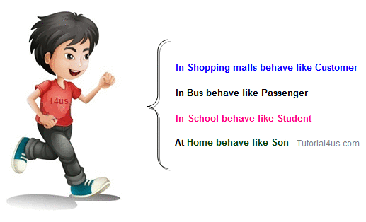
Minh hoạ Đa hình
[Source: Tutorial4us.com]

Slide 3
Case Study: Payroll System Using Polymorphism (cont.)
Problem: A company pays its employees weekly. The employees are of three types:
  salaried employees are paid a fixed weekly salary regardless of the number of hours worked,
  commission employees are paid a percentage of their sales and
  base-salary-plus-commission employees receive a base salary plus a percentage of their sales.
  The company has decided to reward base-salary-plus-commission employees by adding 10 percent to their base salaries.
  The company wants to implement a C++ program that performs its payroll calculations polymorphically.
We use abstract class Employee to represent the general concept of an employee.

Slide 4
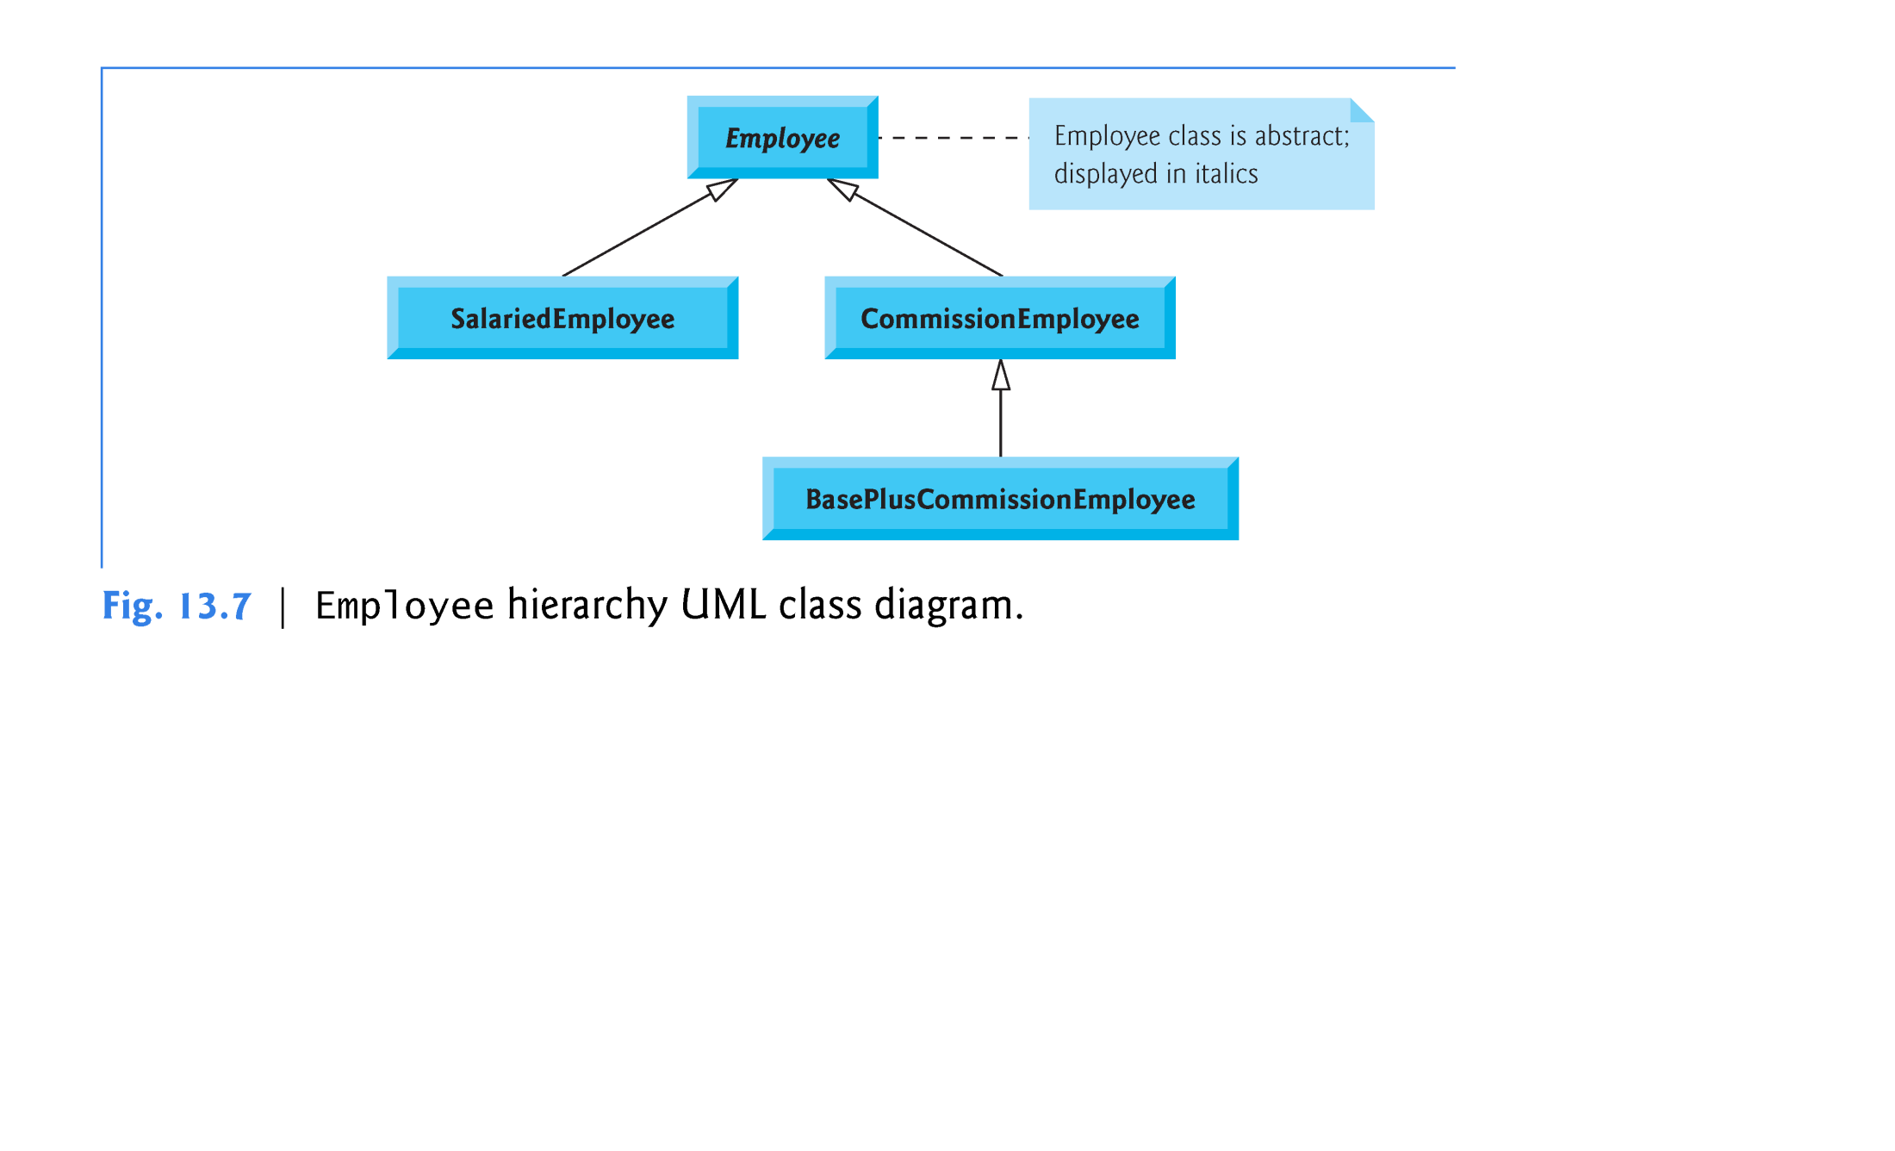

Slide 5
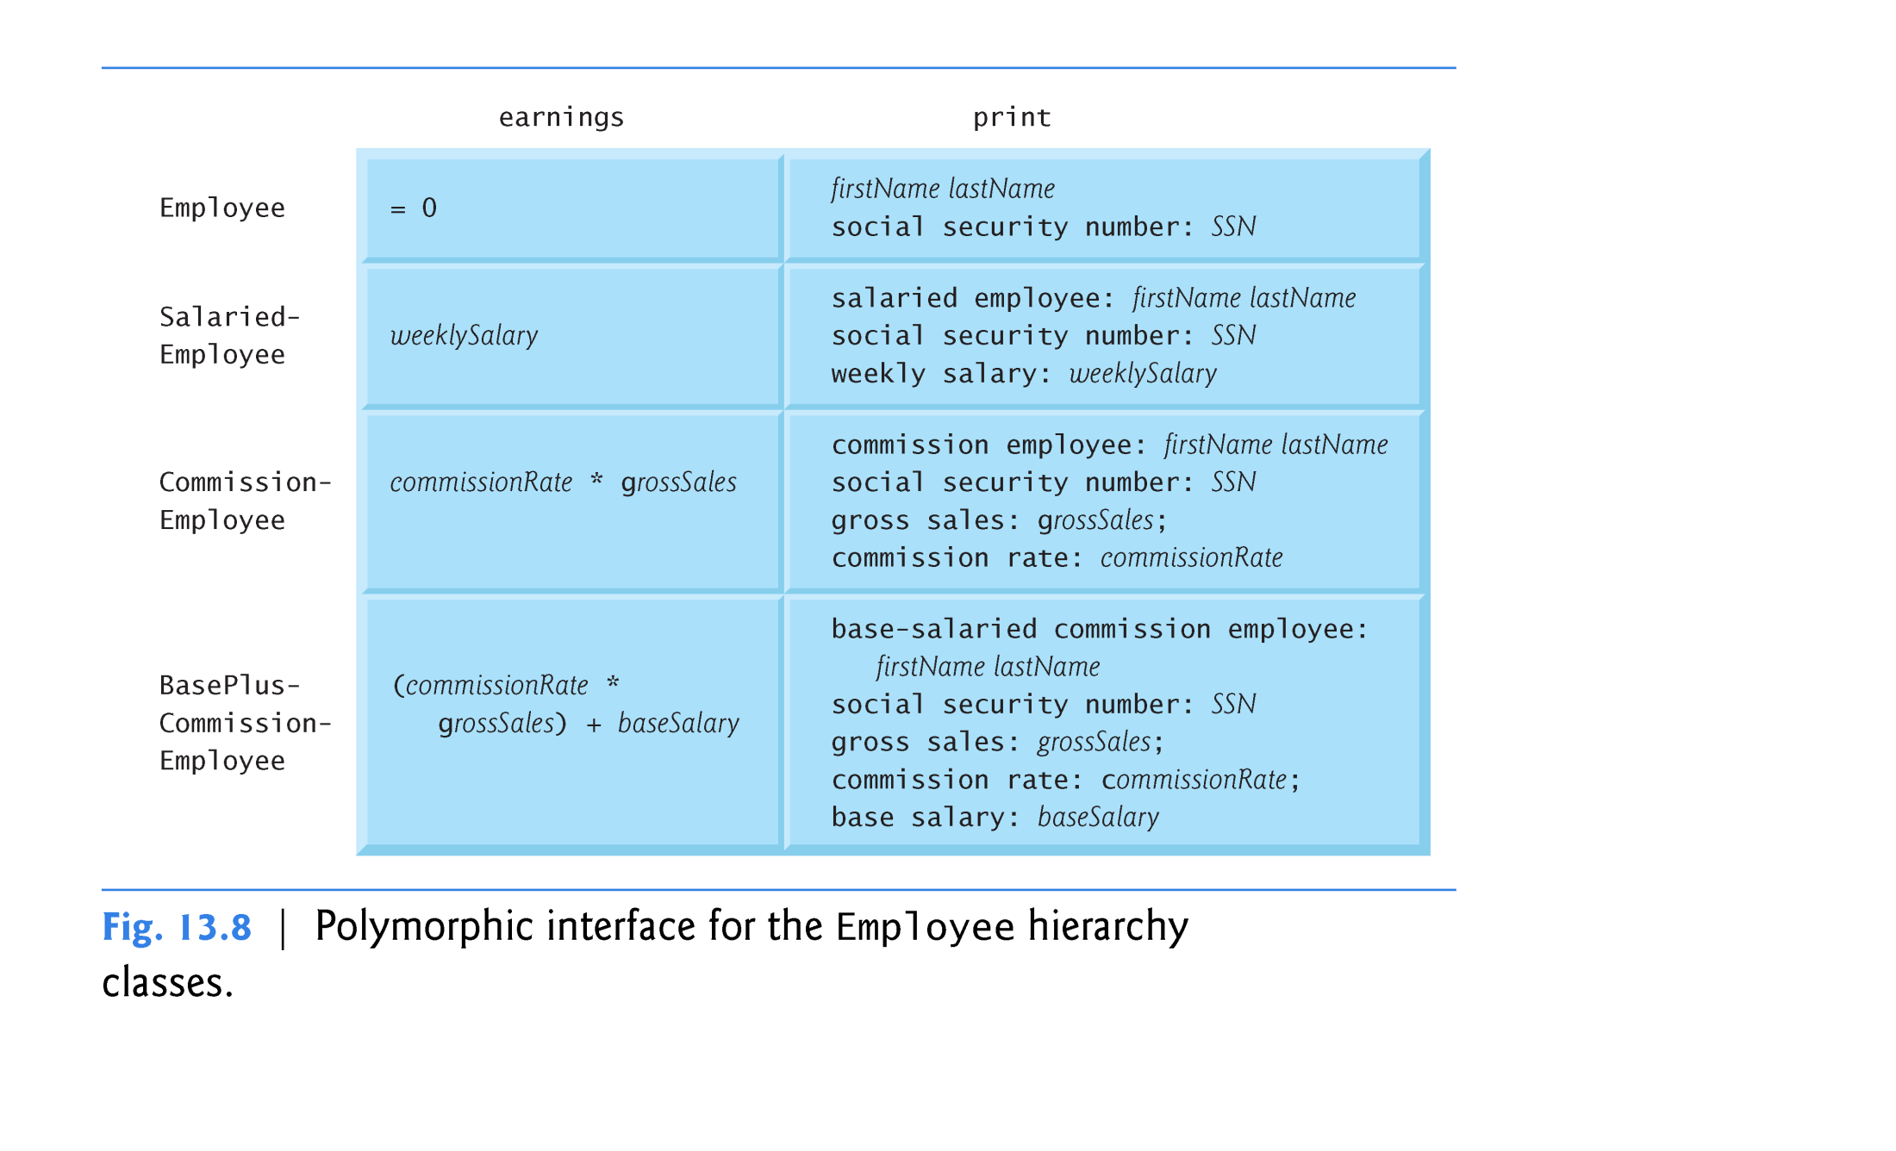

Slide 6
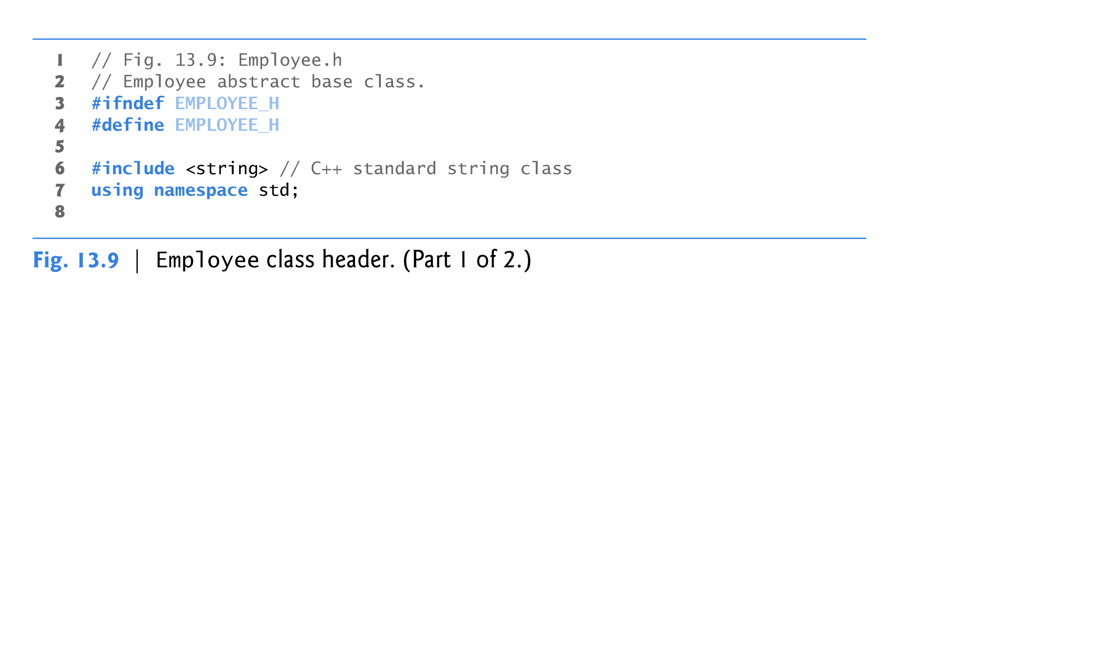
Abstract Base Class: Employee

Slide 7
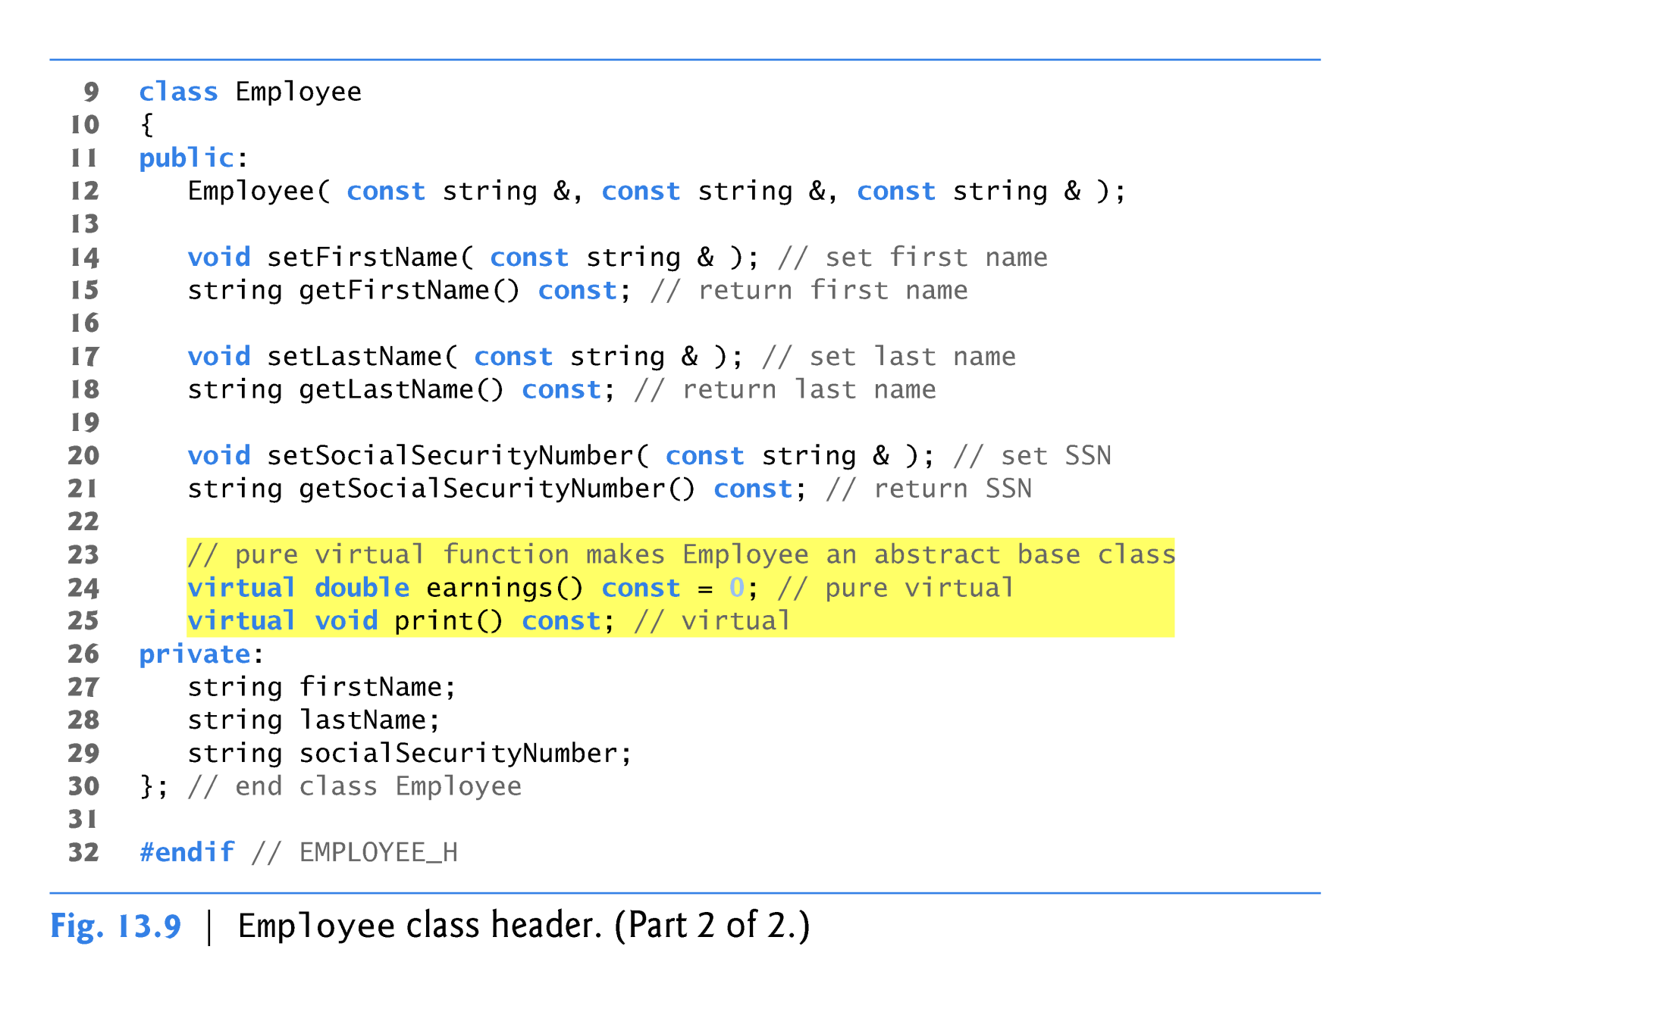
Abstract Base Class: Employee

Slide 8
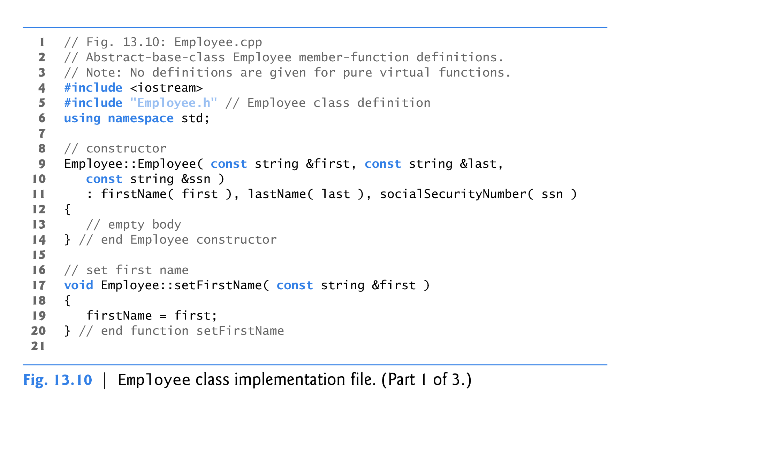
Abstract Base Class: Employee

Slide 9
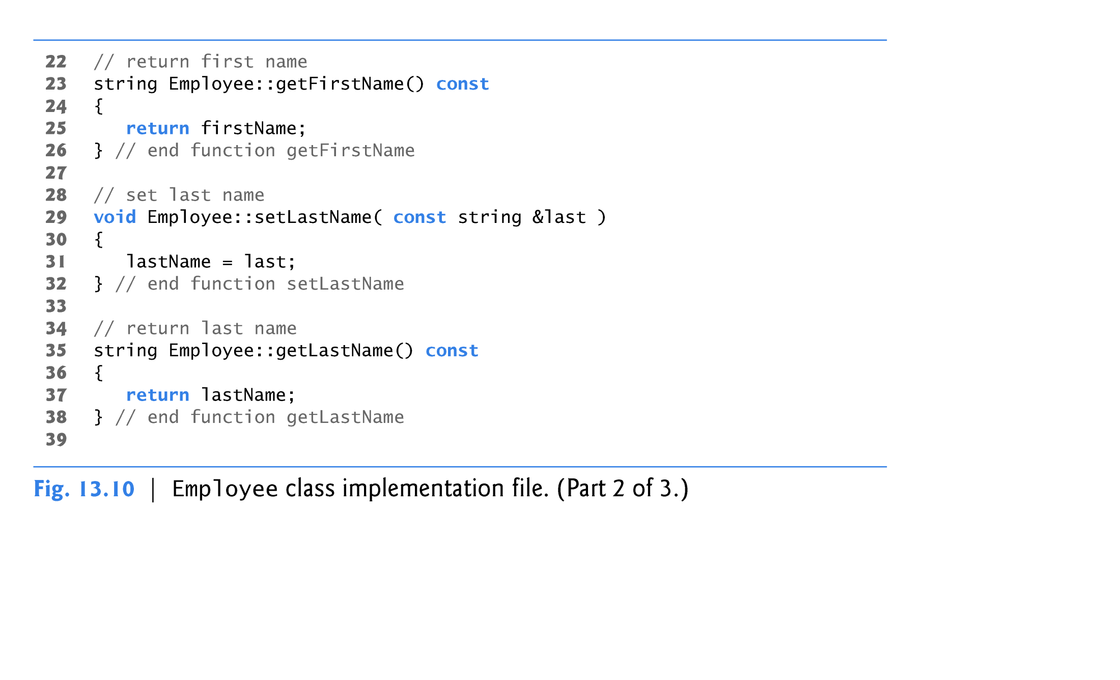
Abstract Base Class: Employee

Slide 10
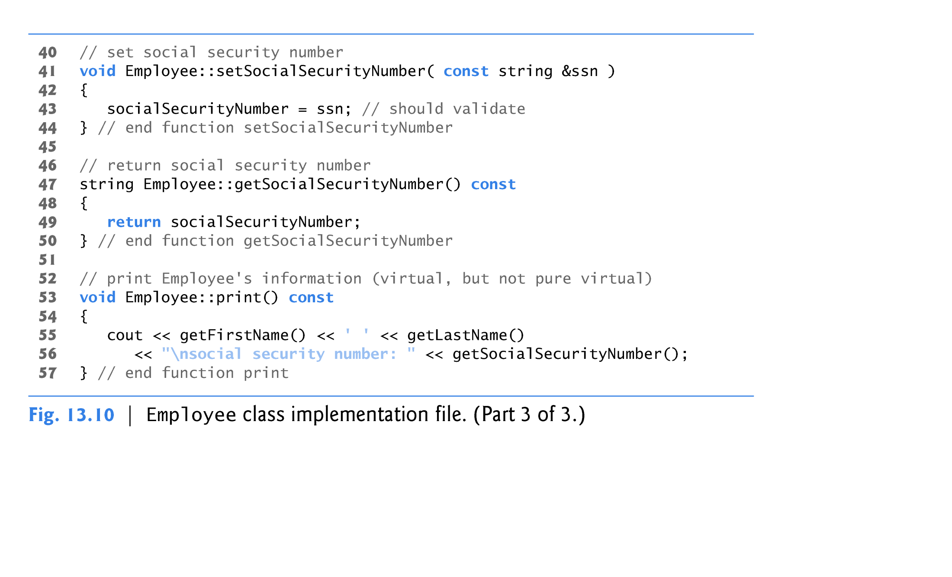
Abstract Base Class: Employee
Abstract Base Class Employee’s print () is a virtual member function but not pure virtual function
It has an implementation
pure virtual function earnings() has no definition/implementation

Slide 11
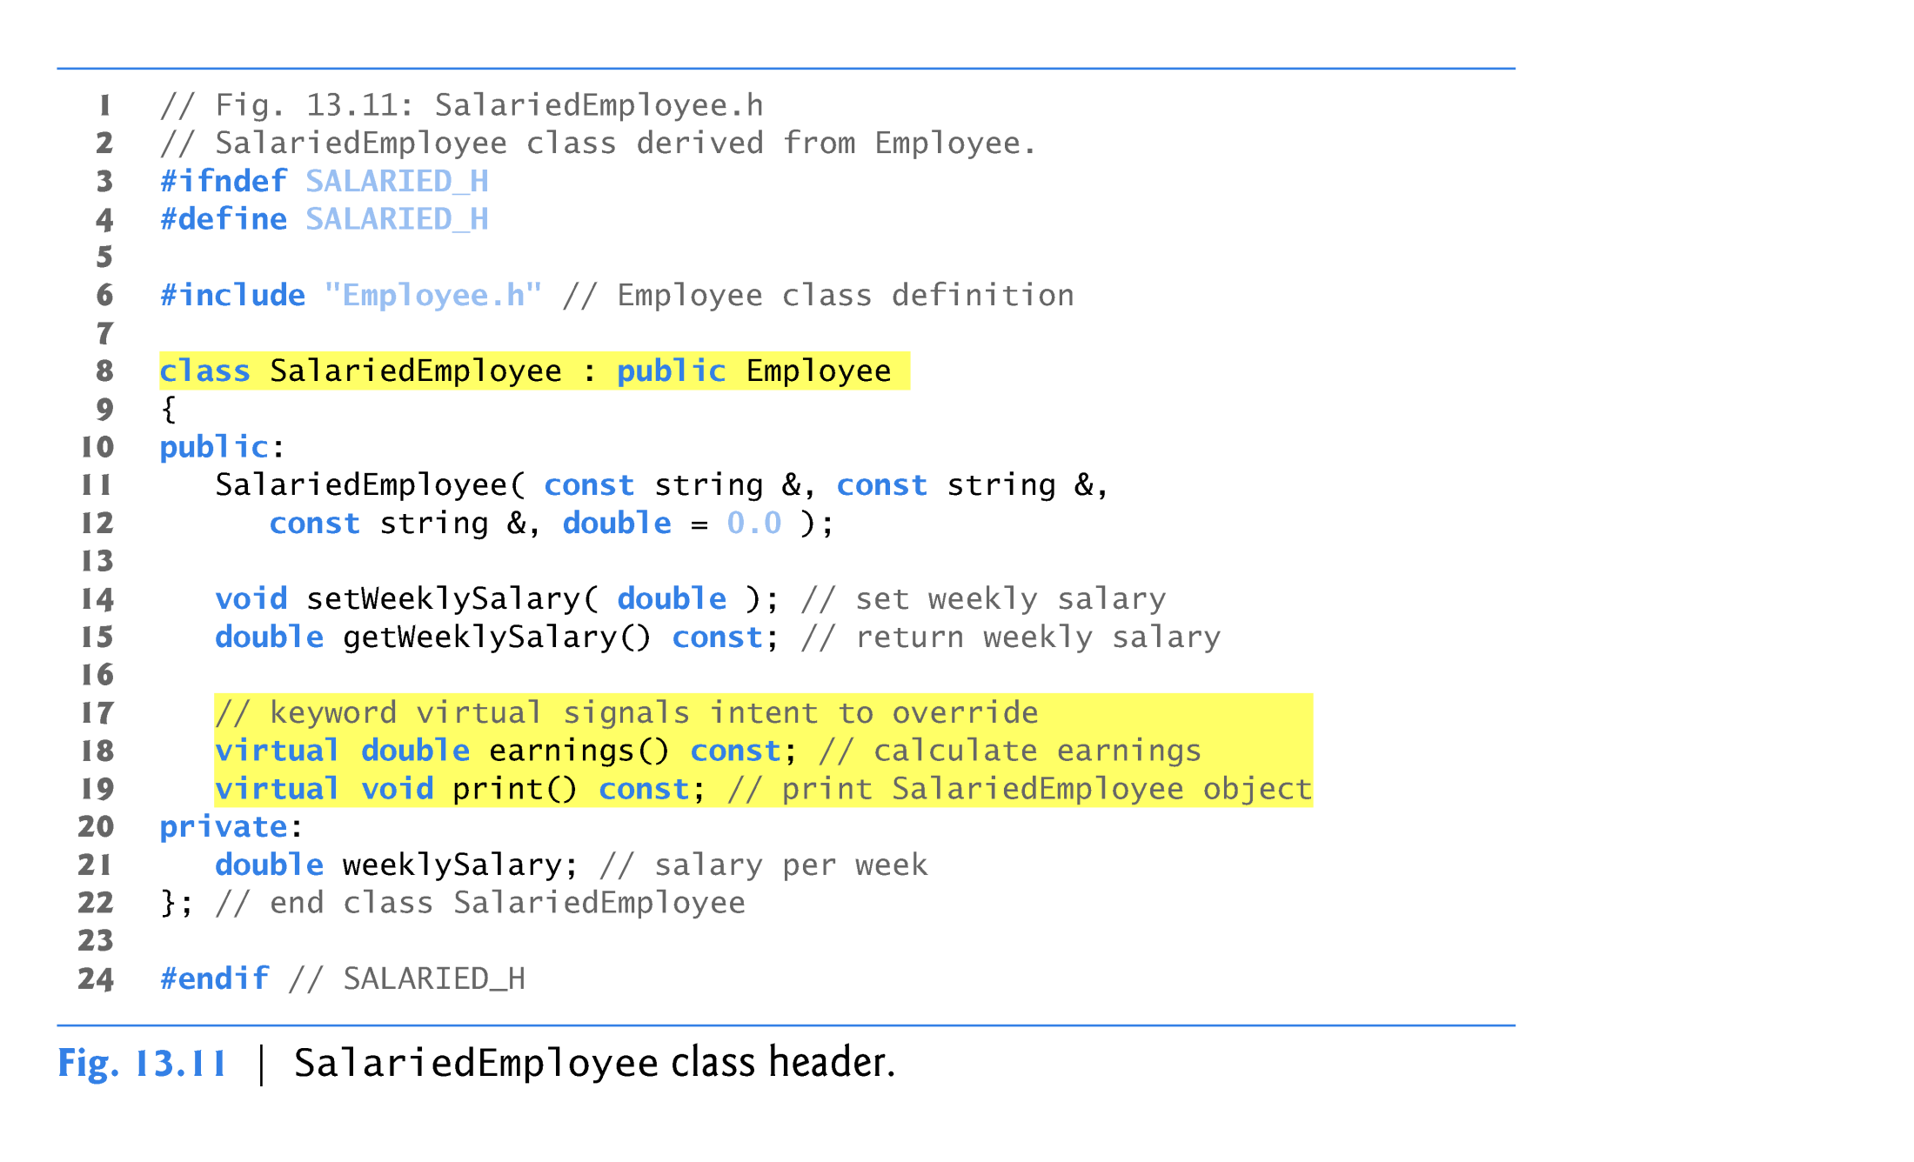
Concrete Derived Class SalariedEmployee
Class SalariedEmployee
derives from class Employee.
Override Abstract Base-Class’s print() & earnings() function

Slide 12
Concrete Derived Class SalariedEmployee (cont.)
Function earnings overrides pure virtual function earnings in Employee to provide a concrete implementation that returns the SalariedEmployee’s weekly salary.
If we did not implement earnings, class SalariedEmployee would be an abstract class.
In class SalariedEmployee’s header, we declared member functions earnings and print as virtual
  This is redundant.
  We defined them as virtual in base class Employee, so they remain virtual functions throughout the class hierarchy.

Slide 13
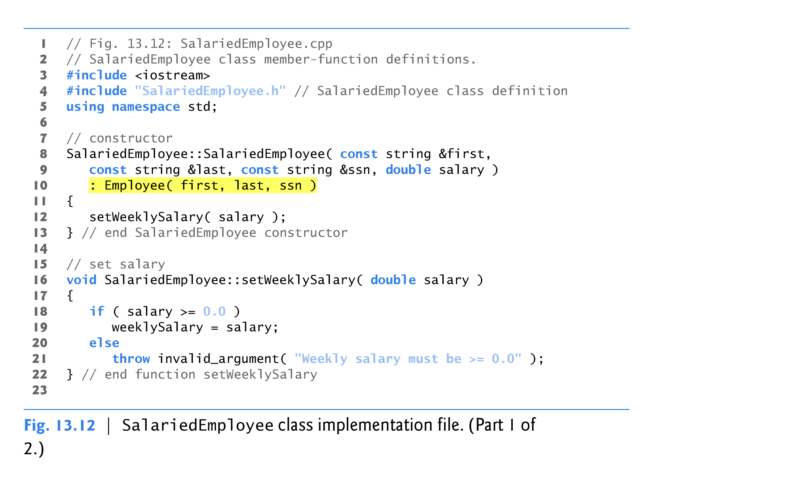
Concrete Derived Class SalariedEmployee (cont.)

Slide 14
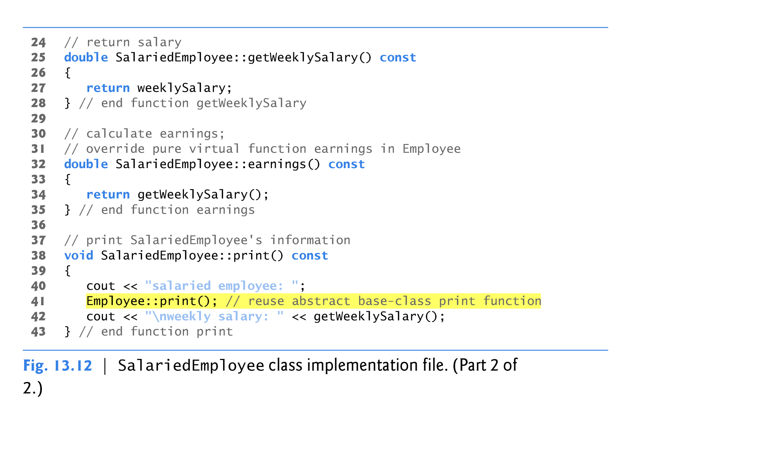
Concrete Derived Class SalariedEmployee (cont.)
Override pure virtual function earnings()
Definition of print() in derived-class

Slide 15
Concrete Derived Class SalariedEmployee (cont.)
Function print of class SalariedEmployee overrides Employee function print.
If class SalariedEmployee did not override print, SalariedEmployee would inherit the Employee version of print.

Slide 16
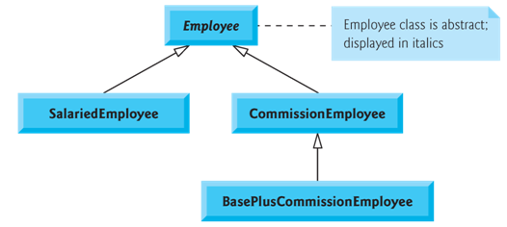
Another Concrete Derived Class CommissionEmployee
Class CommissionEmployee derives from Employee .
The constructor passes the first name, last name and social security number to the Employee constructor to initialize Employee’s private data members.
Function print calls base-class function print to display the Employee-specific
information.

Slide 17
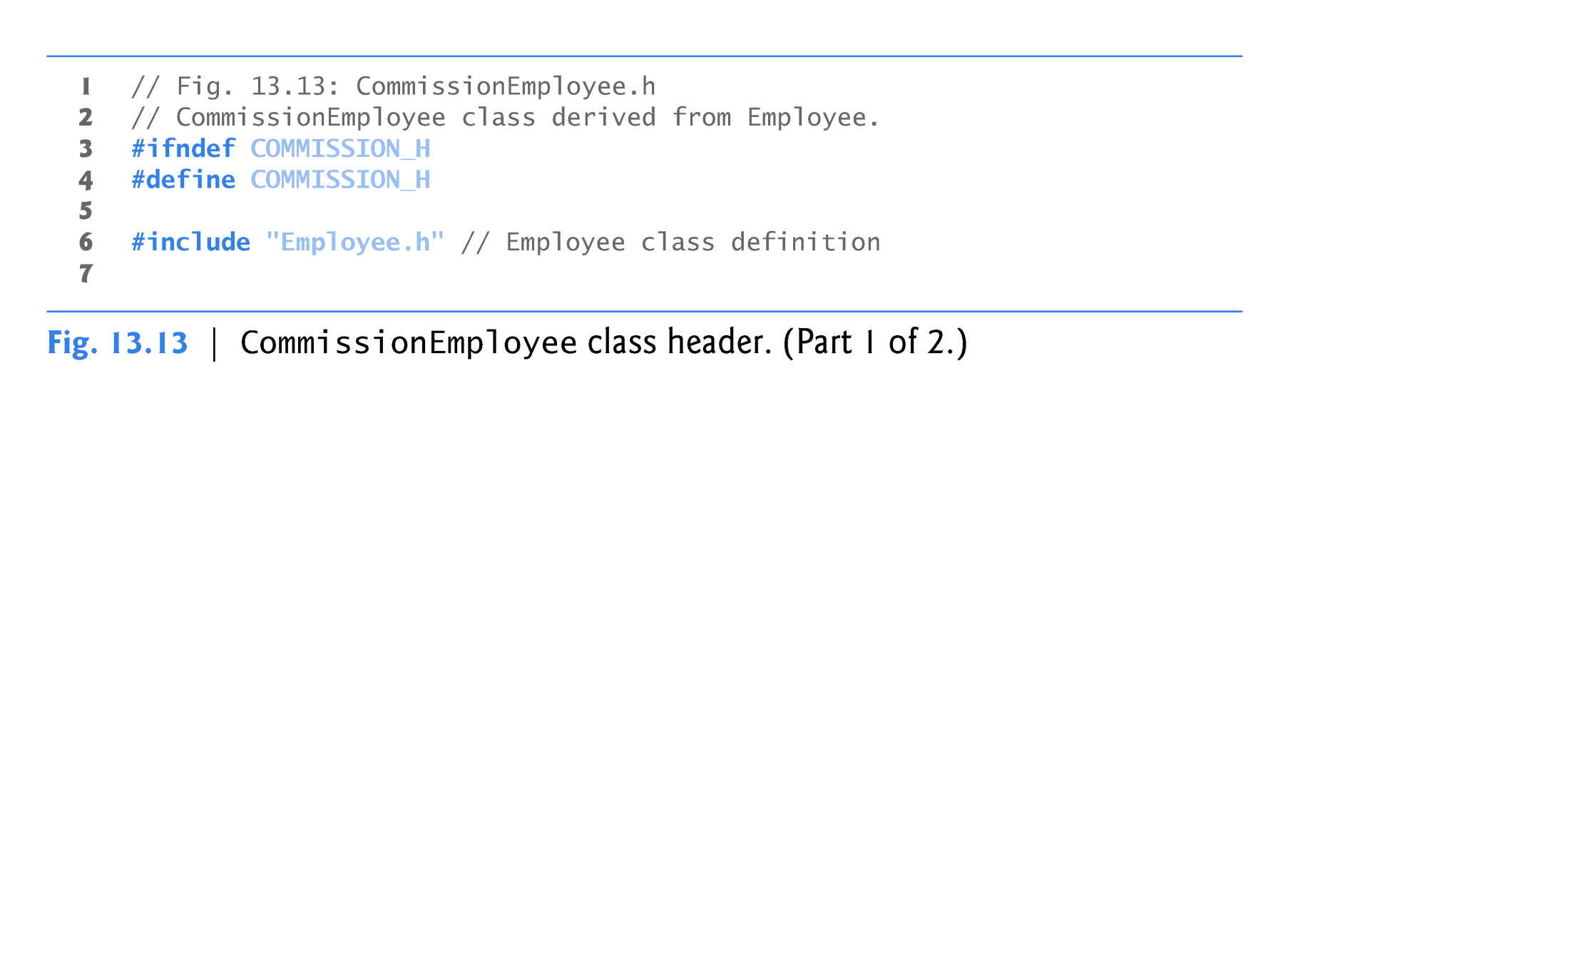
Another Derived Class CommissionEmployee

Slide 18
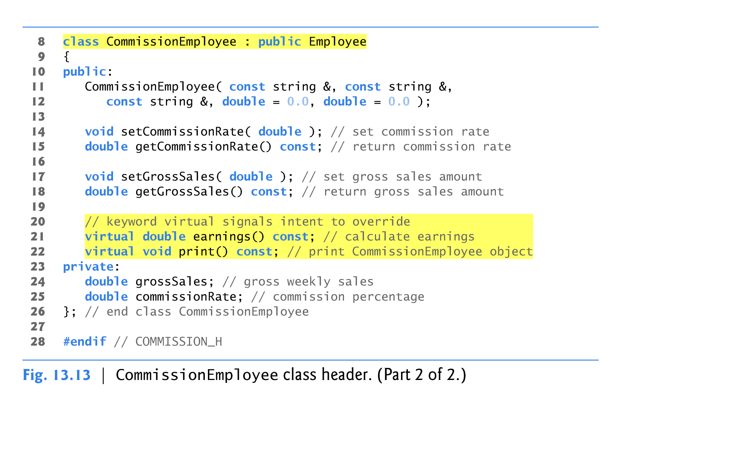
Another Derived Class CommissionEmployee

Slide 19
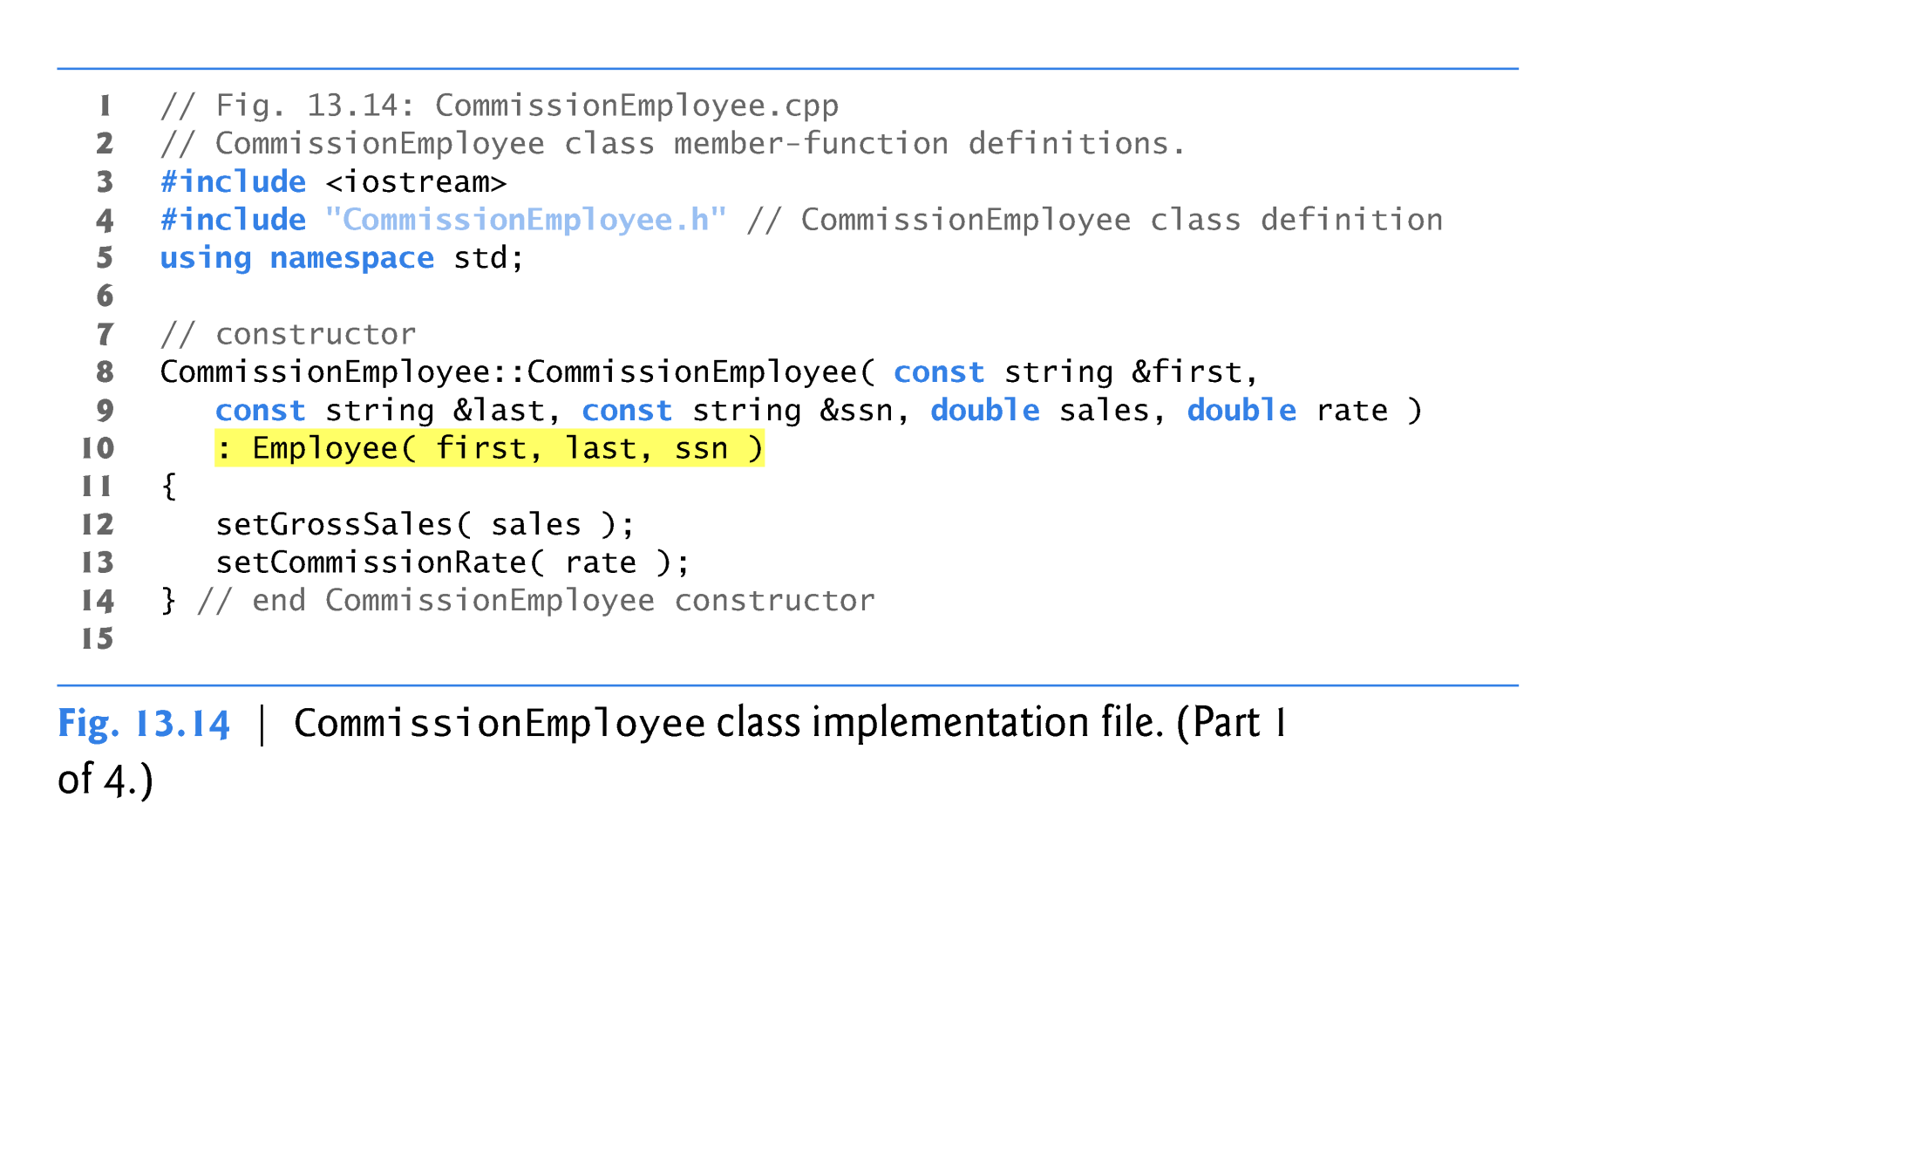
Another Derived Class CommissionEmployee

Slide 20
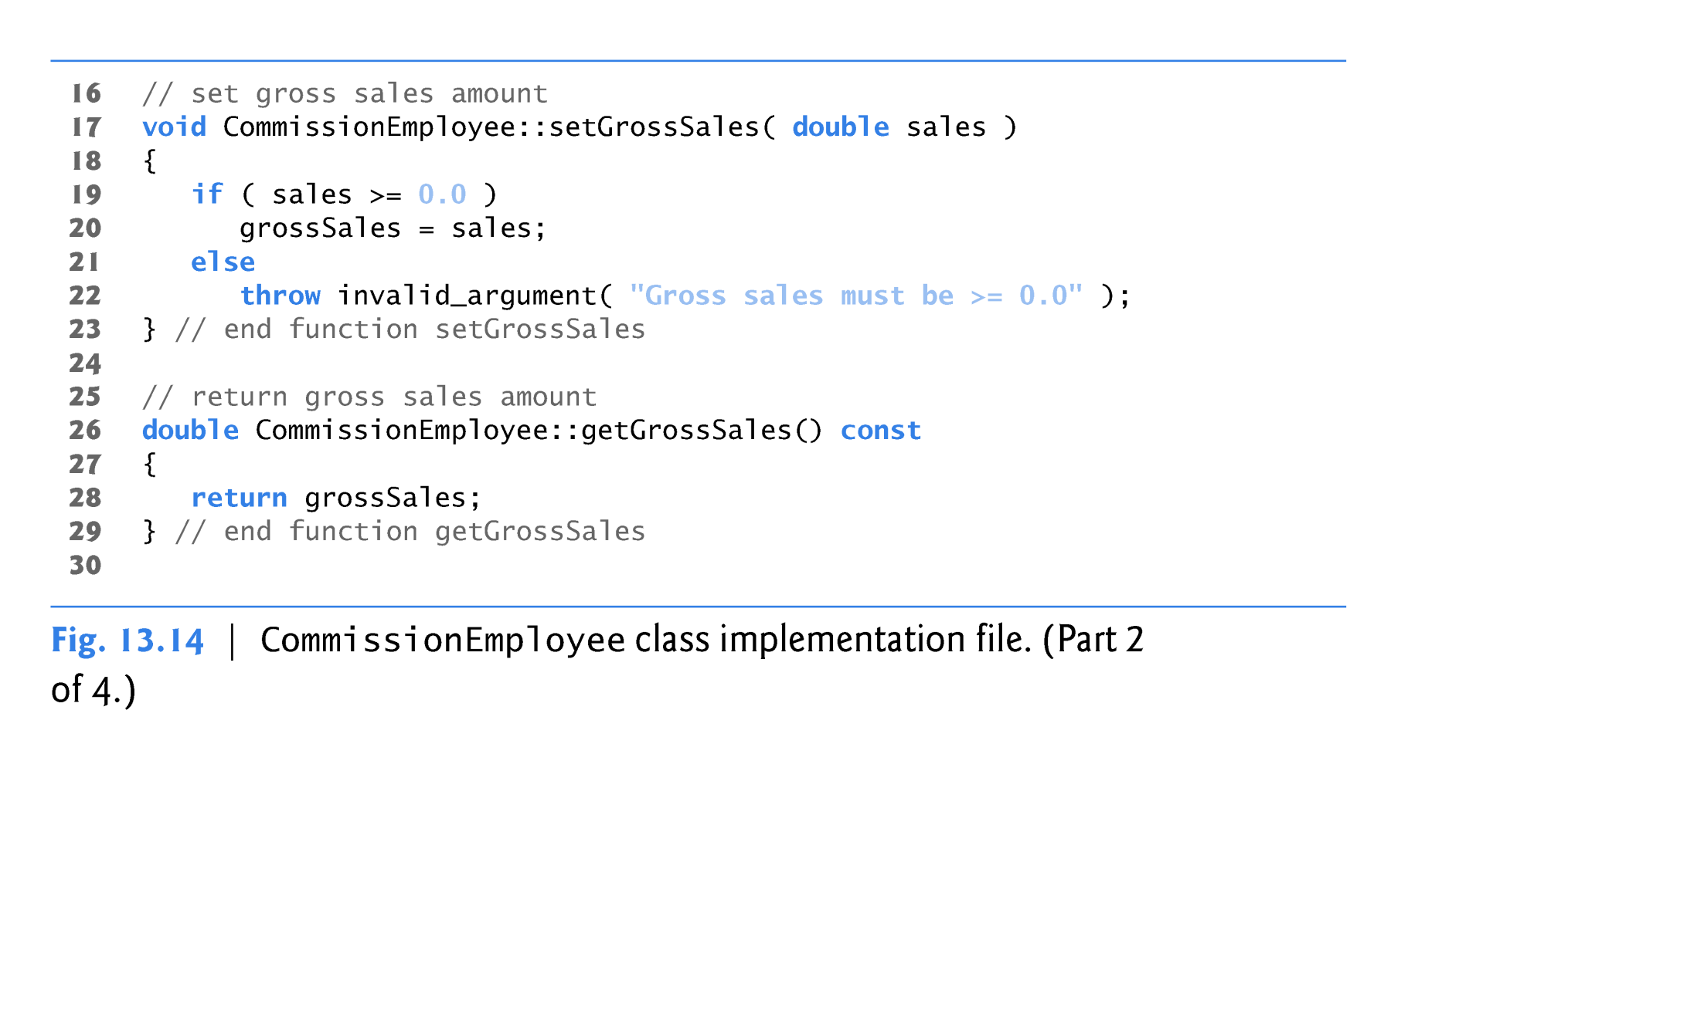
Another Derived Class CommissionEmployee

Slide 21
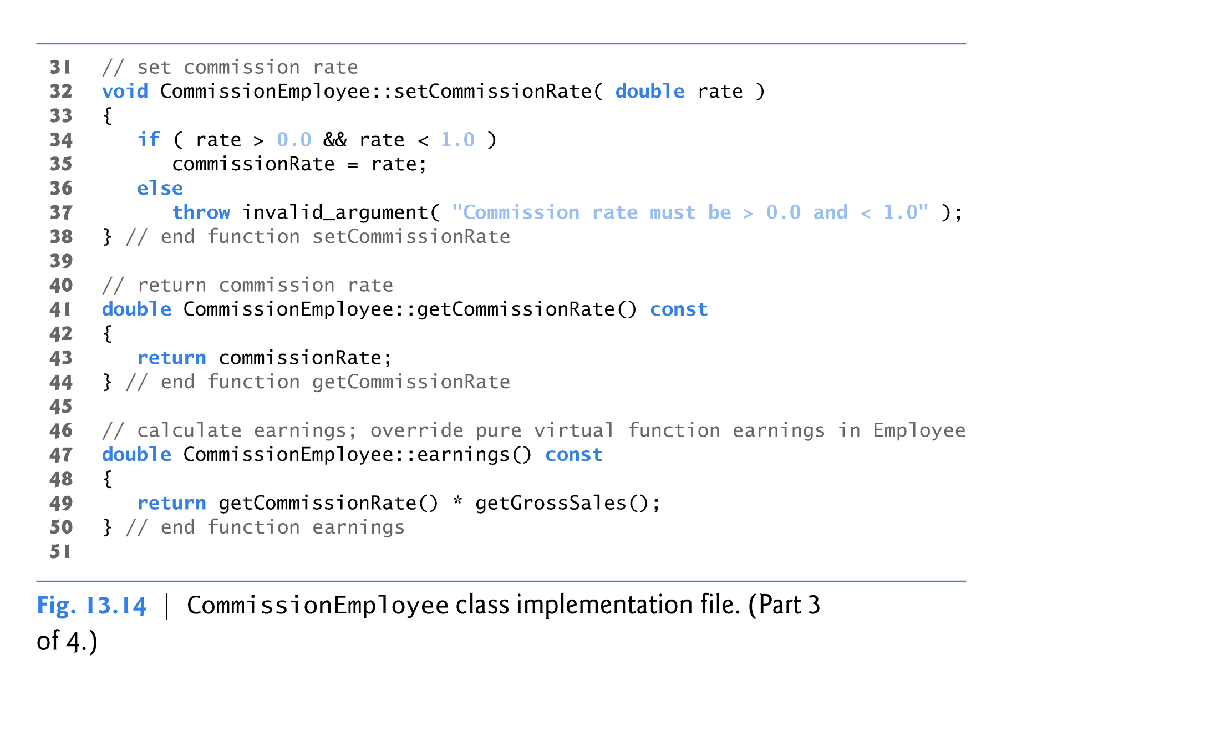
Another Derived Class CommissionEmployee
Override the pure virtual function earnings()

Slide 22
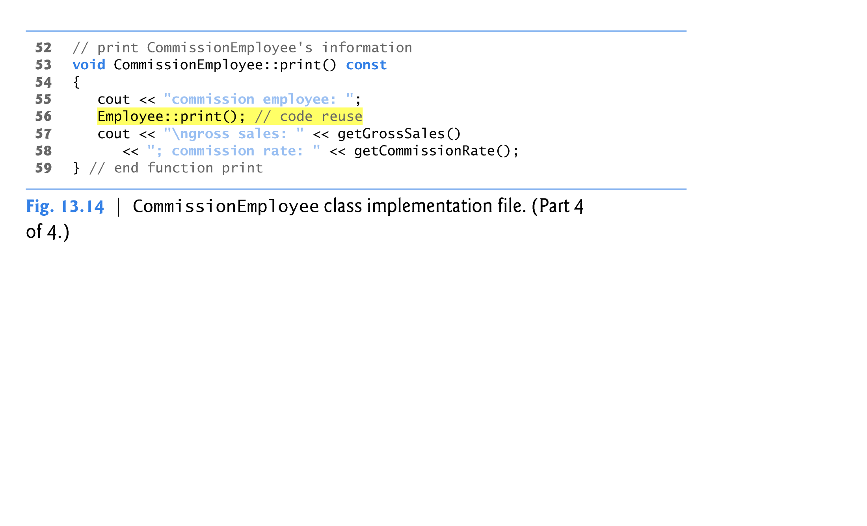
Another Derived Class CommissionEmployee
Definition of print() in derived-class

Slide 23
Indirect Concrete Derived Class BasePlusCommissionEmployee
Class BasePlusCommissionEmployee directly inherits from class CommissionEmployee
  it is an indirect derived class of class Employee.
BasePlusCommissionEmployee’s print function outputs
  "base-salaried", followed by the output of base-class CommissionEmployee’s print function (another example of code reuse), then the base salary.

Slide 24
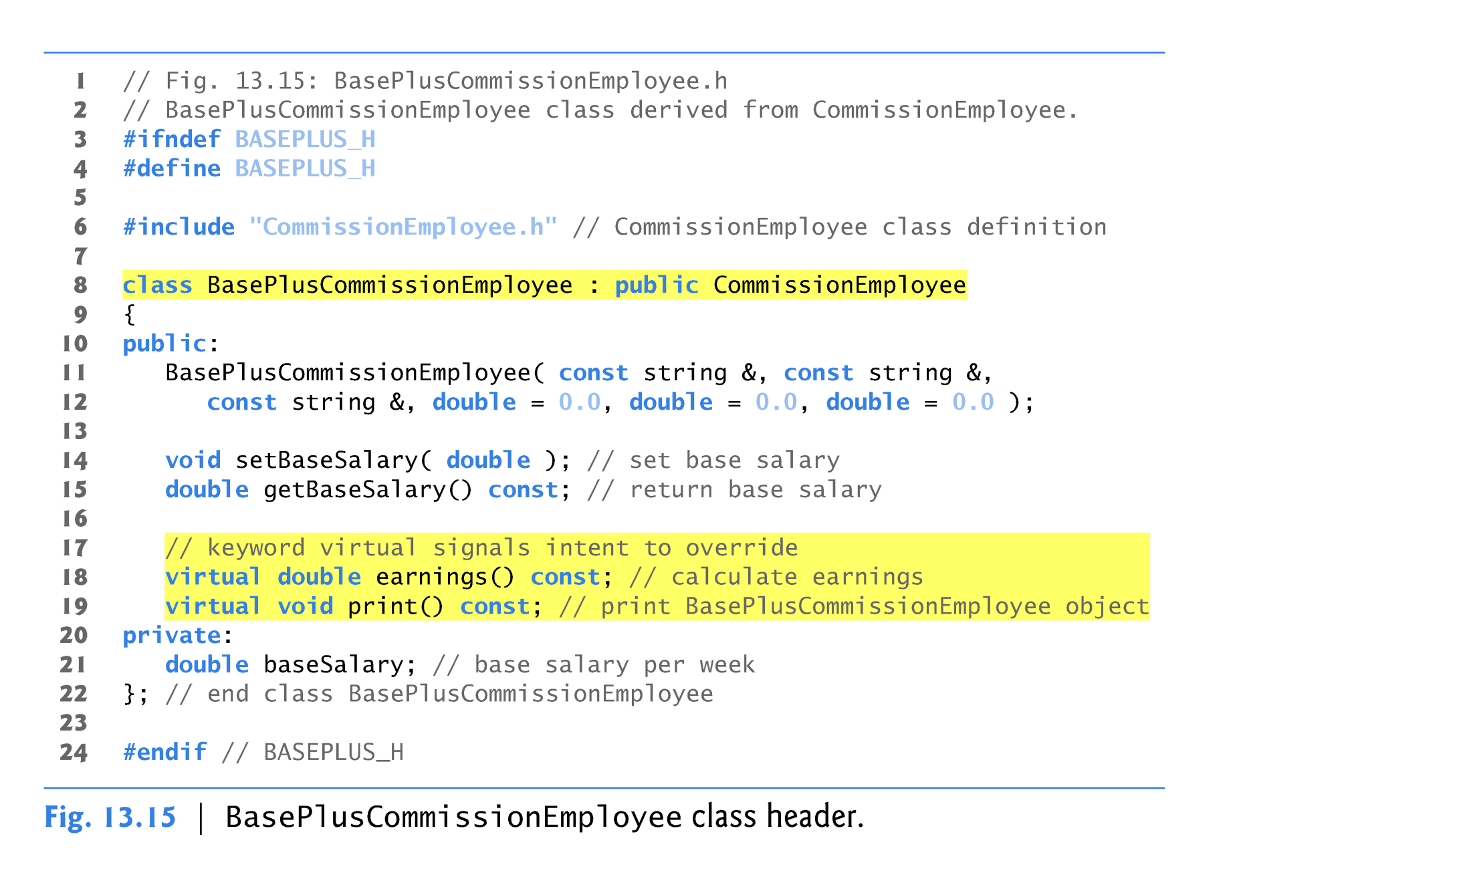
Indirect Concrete Derived Class BasePlusCommissionEmployee

Slide 25
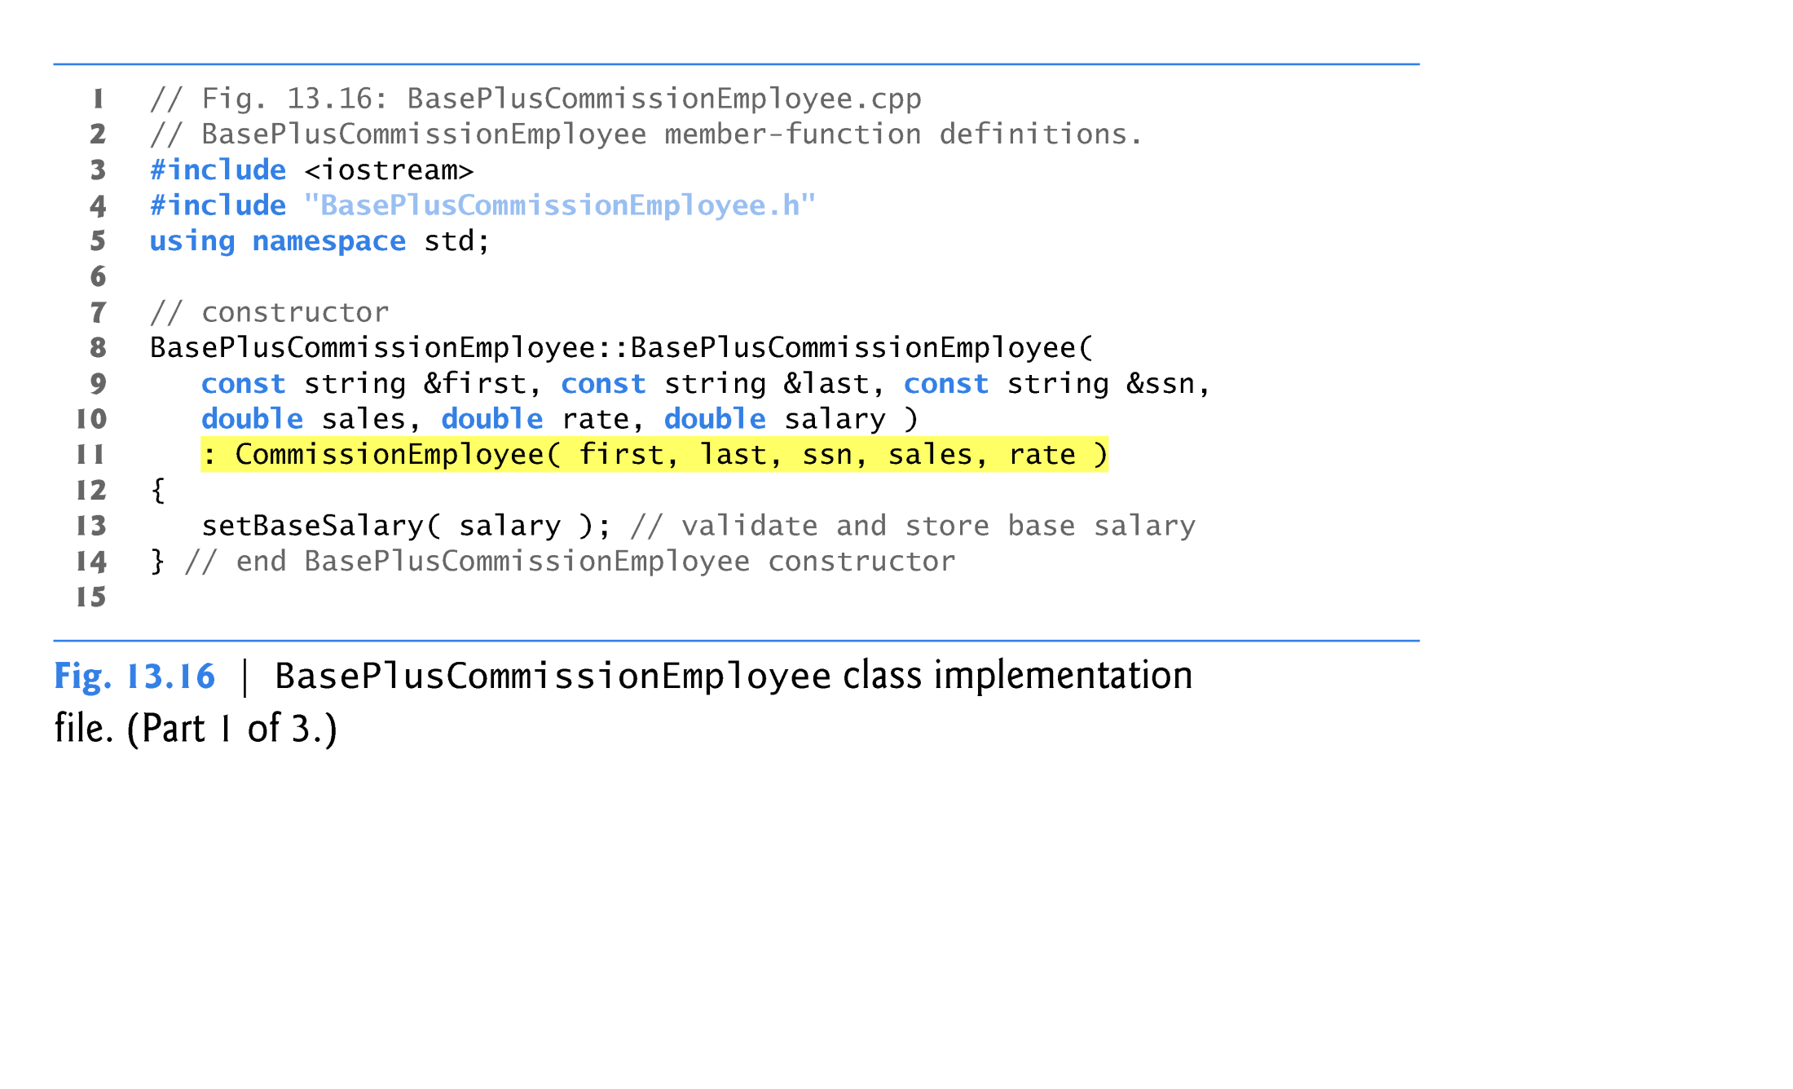
Indirect Concrete Derived Class BasePlusCommissionEmployee

Slide 26
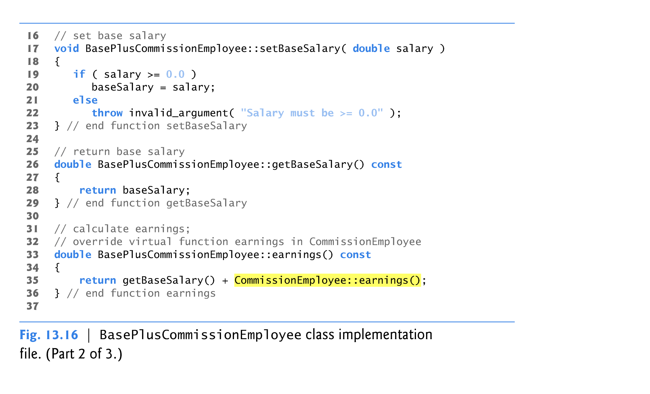
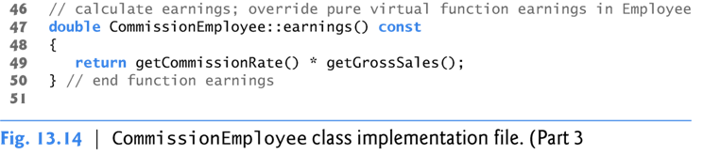
Indirect Concrete Derived Class BasePlusCommissionEmployee
Definition of virtual function earnings() in derived-class

Slide 27
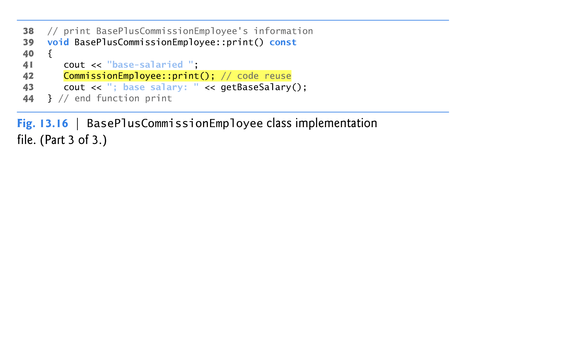
Indirect Concrete Derived Class BasePlusCommissionEmployee
Definition of print() in derived-class

Slide 28
Demonstrating Polymorphic Processing
Create an object of each of the three concrete classes SalariedEmployee, CommissionEmployee and BasePlusCommissionEmployee.
Manipulates these objects
  static binding,
  polymorphically, using a vector of Employee pointers.
Each member-function invocation is an example of static binding
  at compile time, because we are using name handles (not pointers or references that could be set at execution time)
  the compiler can identify each object’s type to determine which print and earnings functions are called.

Slide 29
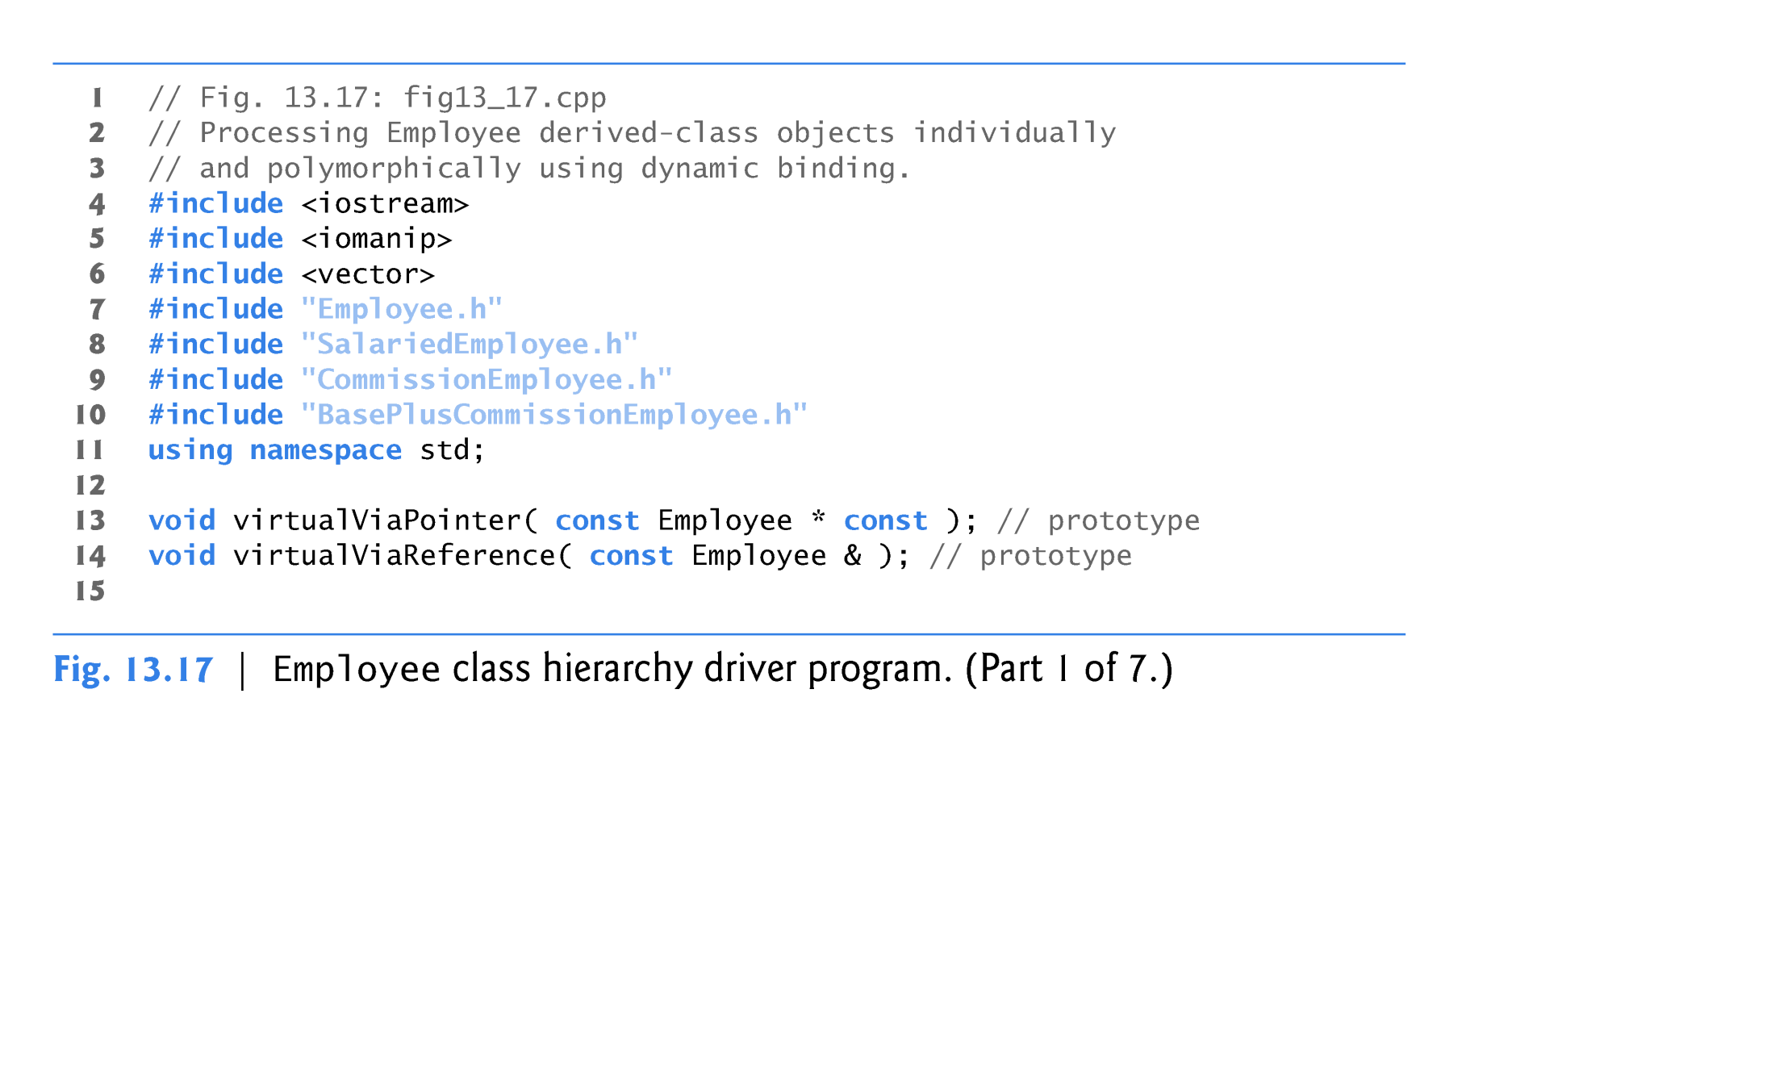
Example: Polymorphic Processing
const Employee * :pointer to an object and the object cannot be modified.
Employee * const :you cannot change what the pointer points to.
const Employee * const :a pointer which cannot be changed to point to something else, nor can it be used to change the object it points to.

Slide 30
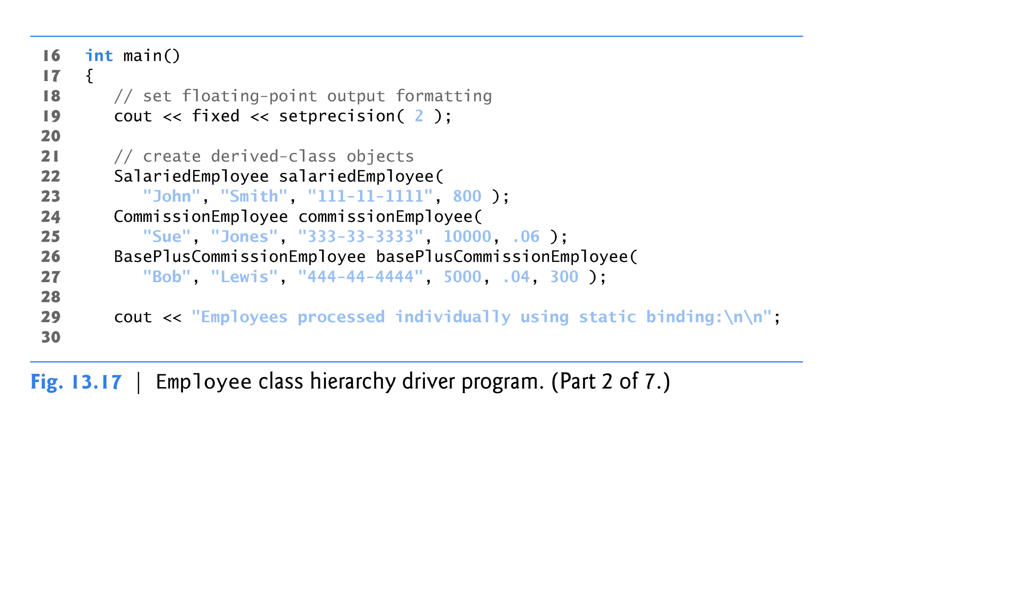
Example: Polymorphic Processing

Slide 31
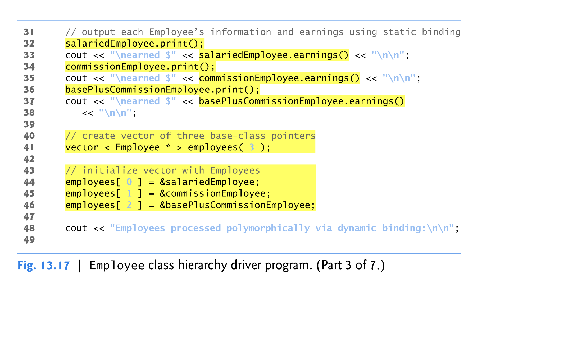
Example: Polymorphic Processing

Slide 32
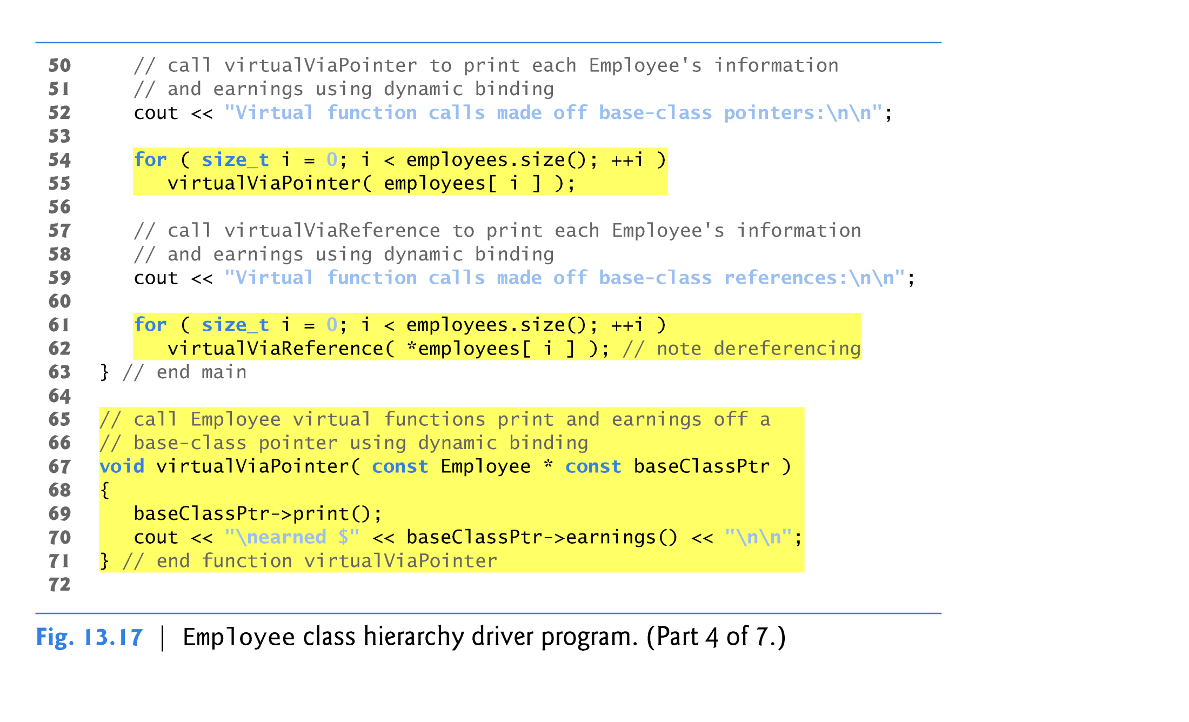
Example: Polymorphic Processing

Slide 33
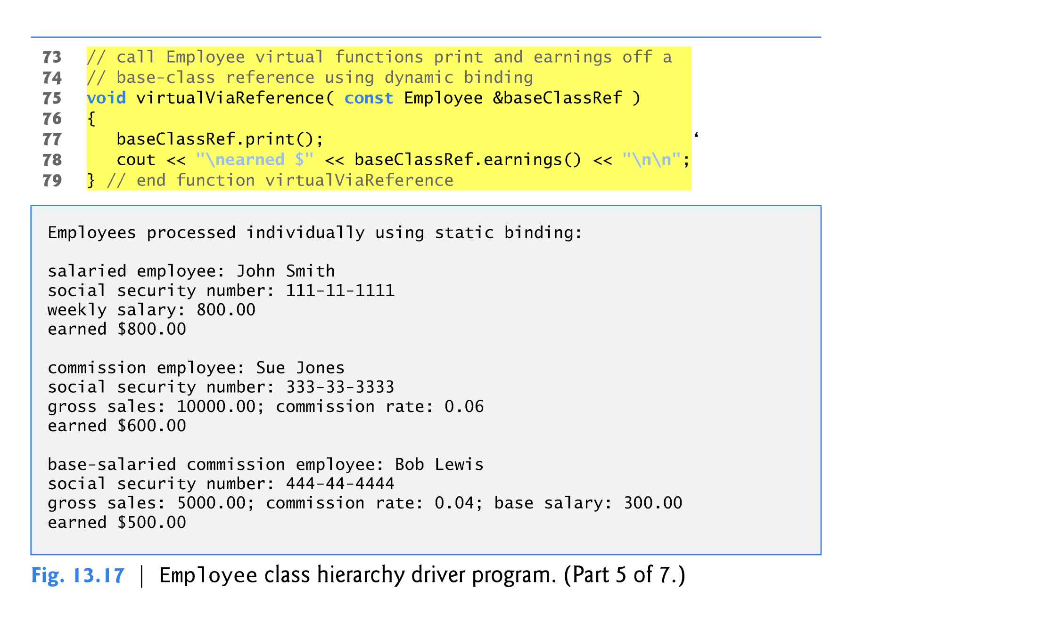
Example: Polymorphic Processing

Slide 34
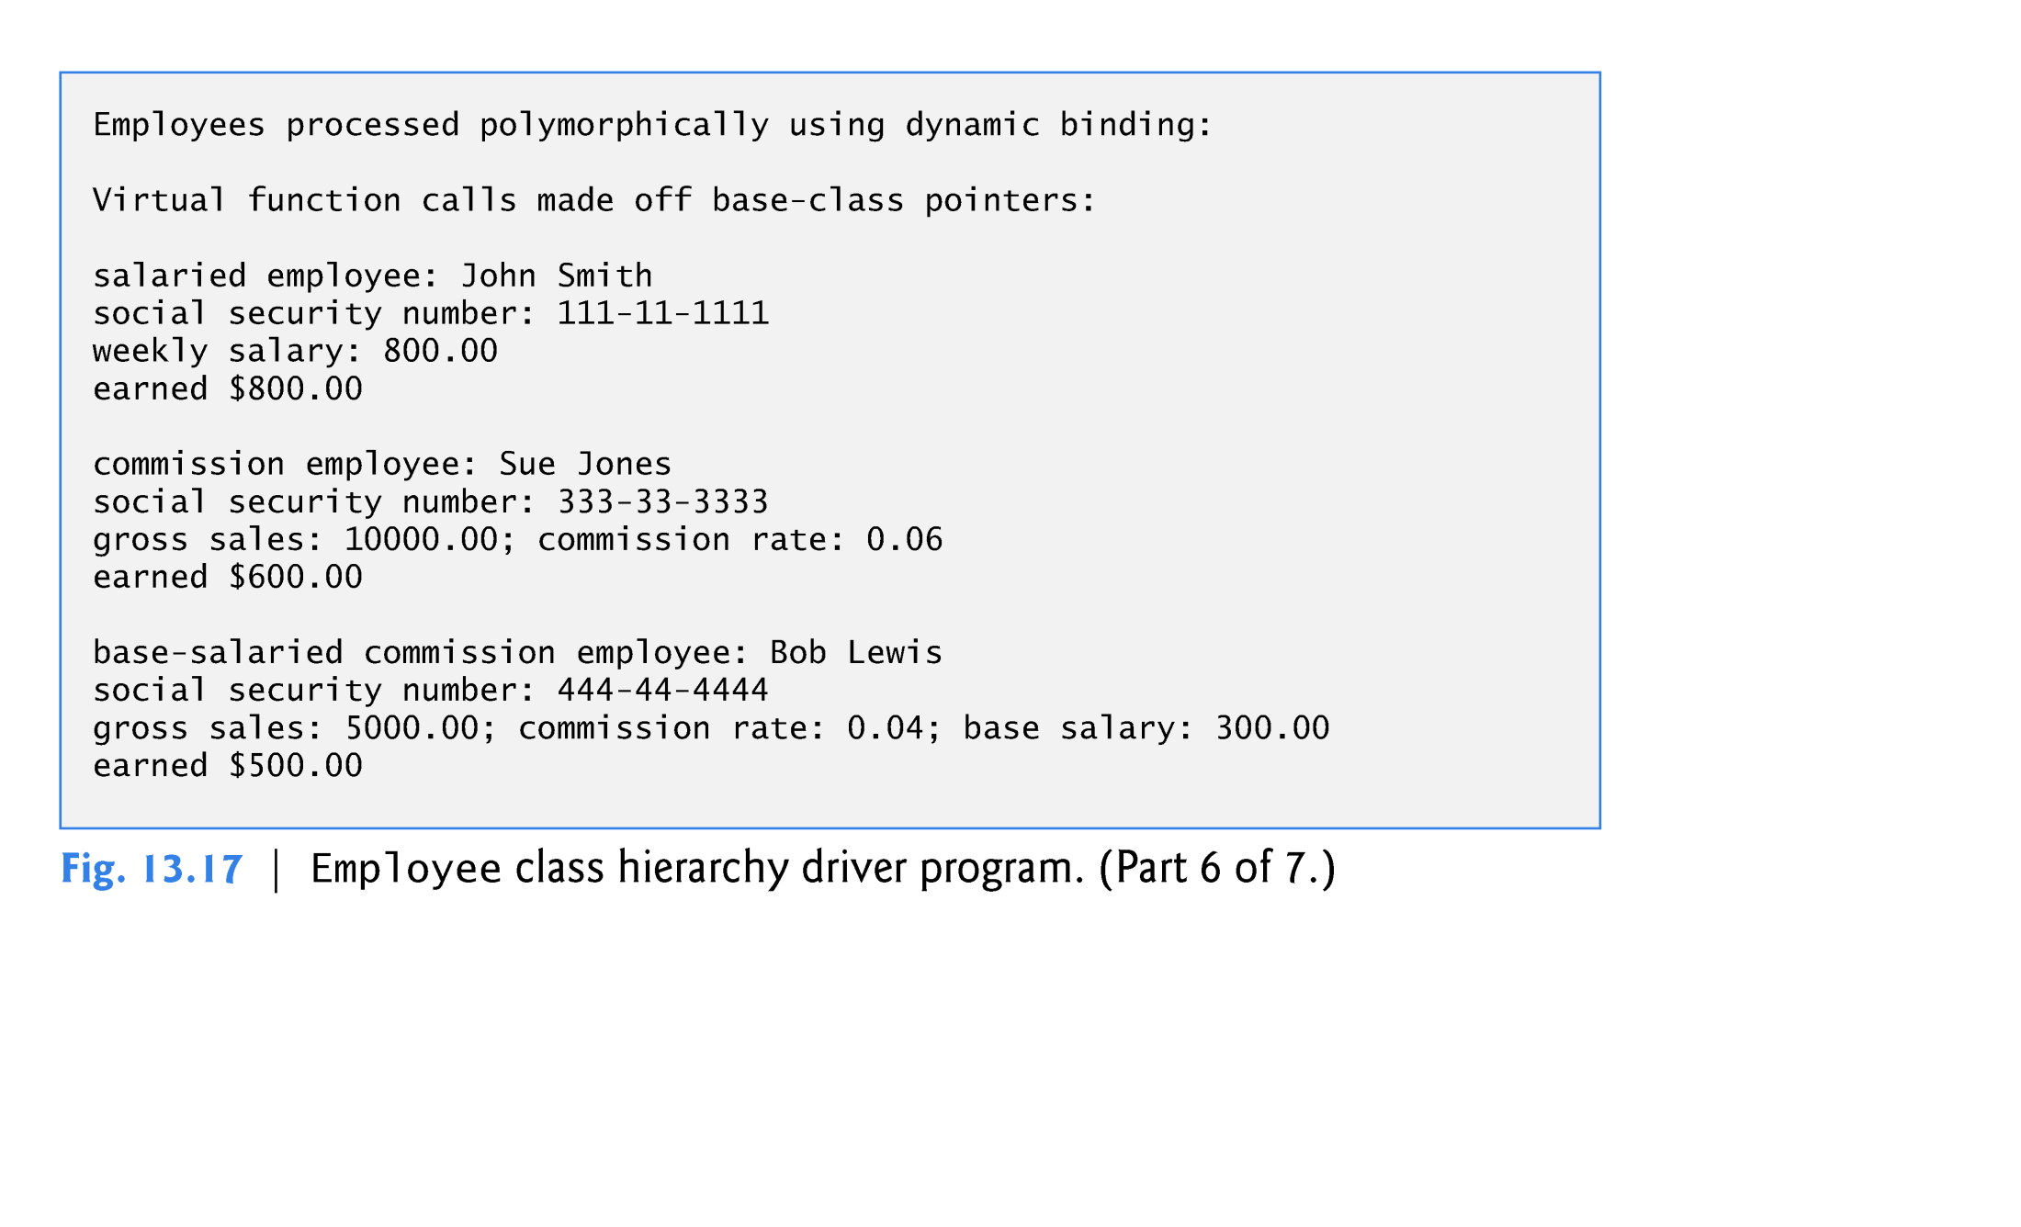
Example: Polymorphic Processing

Slide 35

Example: Polymorphic Processing

Slide 36
Polymorphic Processing (cont.)
vector employees, which contains three Employee pointers.
employees[ 0 ] at object salariedEmployee.
employees[ 1 ] at object commissionEmployee.
employees[ 2 ] at object basePlusCommissionEmployee.
The compiler allows these assignments, because a SalariedEmployee is an Employee, a CommissionEmployee is an Employee and a BasePlusCommissionEmployee is an Employee.

Slide 37
Polymorphic Processing (cont.)
Function virtualViaPointer receives in parameter baseClassPtr (of type const Employee * const) the address stored in an employees element.
Each call to virtualViaPointer uses baseClassPtr to invoke virtual functions print and earnings
Note that function virtualViaPointer does not contain any SalariedEmployee, CommissionEmployee or BasePlusCommissionEmployee type information.
The function knows only about base-class type Employee.
The output illustrates that the appropriate functions for each class are indeed invoked and that each object’s proper information is displayed.

Slide 38
Polymorphic Processing (cont.)
Function virtualViaReference receives in its parameter baseClassRef (of type const Employee &) a reference to the object obtained by dereferencing the pointer stored in each employees element.
Each call to virtualViaReference invokes virtual functions print and earnings via reference baseClassRef to demonstrate that polymorphic processing occurs with base-class references as well.
Each virtual-function invocation calls the function on the object to which baseClassRef refers at runtime.
This is another example of dynamic binding.
The output produced using base-class references is identical to the output produced using base-class pointers.

